Slide 1
Should India set itself a net-zero emissions goal and what would a just transition entail?
IISD-IEEFA Webinar on Opportunities in crises: Role of energy taxes & stimulus in shaping India's green recovery
Ulka Kelkar, Director - Climate program, WRI India

Slide 2
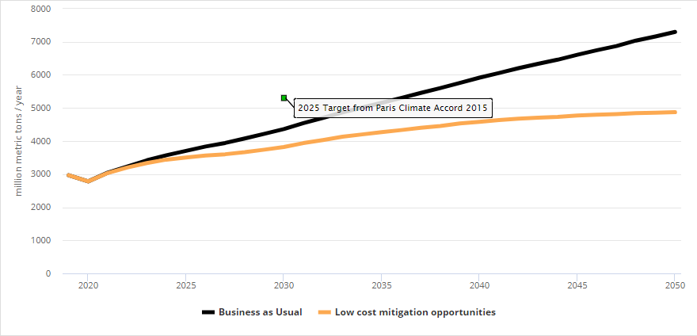
Scenario: Total Emissions Abated
MMT CO2e | 2035 | 2050
BAU | 5156 | 7299
Scenario 1 | 4267 | 4873
% emissions abated from BAU | 17% | 33%
Policies with highest abatement potential in 2035 (~93%): Electrification + Hydrogen in Industry (27%),
Early Retirement of Coal Plants (21%),
Hydrogen production using electrolysis (16%),
Carbon-free electricity standard (10%),
Mode shifting (10%),
Industry EE Standards (9%)
Source: https://india.energypolicy.solutions

Slide 3
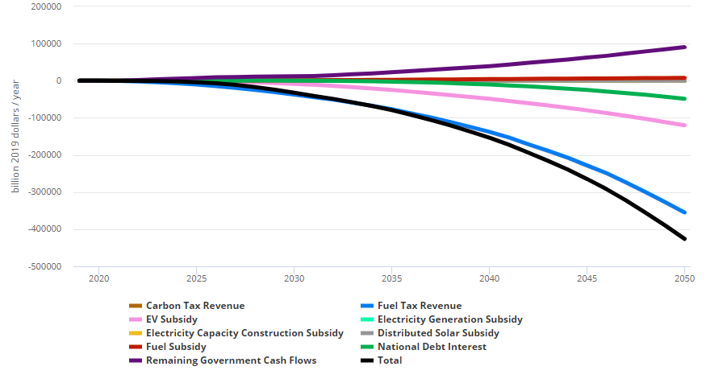
Potential Change in Government Cash Flow, by sources
Potential reduction in government revenue due to reduced fossil fuel taxes revenue
Source: https://india.energypolicy.solutions

Slide 4
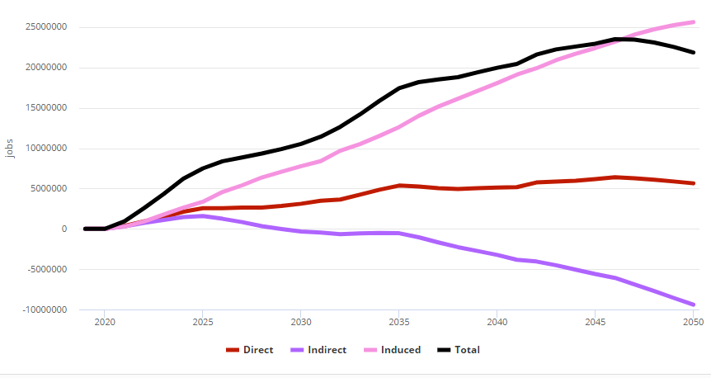
Potential Impact on Jobs
Scenario: Introducing a carbon tax policy for industrial sector (linearly phased in to reach a rate of INR 2500/tCO2e by 2050) can help augment government revenue, spending in the economy, and overall job gains
 | 2035 | 2050
Total Jobs Increase | 17,429,300 | 21,862,100
Source: https://india.energypolicy.solutions

Slide 5
Thank you www.wri.org ulka.kelkar@wri.org @UlkaKelkar

